Slide 1

Customer Shopping Behavior Analysis
Uncovering insights from 3,900 purchases to guide strategic business decisions.

Slide 2


Project Overview
1
2
Transactional Data
Uncover Insights
Analysis of 3,900 purchases across categories.
Spending patterns, customer segments, product preferences.
3
Strategic Decisions
Guide business growth and future planning.

Slide 3

Dataset Summary
Key Features
Data Snapshot
Customer demographics (Age, Gender, Location, Subscription)
Rows: 3,900
Purchase details (Item, Category, Amount, Season, Size, Color)
Columns: 18
Shopping behavior (Discount, Promo, Previous Purchases, Frequency, Review, Shipping)
Missing Data: 37 values in Review Rating

Slide 4




Exploratory Data Analysis (Python)
Data Loading & Exploration
Pandas import, df.info(), .describe() for structure.
Data Cleaning
Handle nulls, impute missing Review Ratings (median).
Feature Engineering
Age groups, purchase frequency, column standardization.
Database Integration
Connect to PostgreSQL, load cleaned data for SQL analysis.

Slide 5





Data Analysis (SQL)
Revenue by Gender
High-Spending Discount Users
Female: $75,191, Male: $157,890
839 customers identified.
Top 5 Products by Rating
Gloves (3.86), Sandals (3.84), Boots (3.82), Hat (3.80), Skirt (3.78)

Slide 6

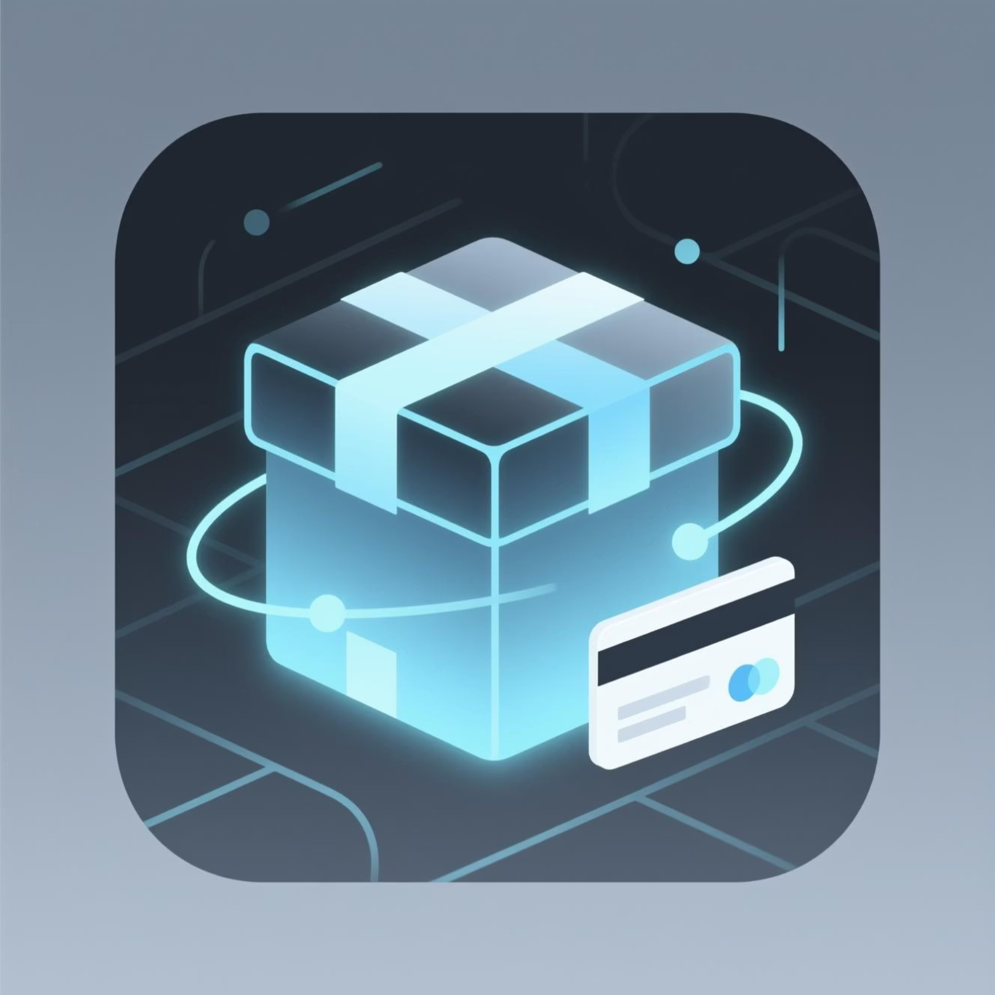
SQL Insights: Shipping & Subscriptions
Shipping Type Comparison
Subscribers vs. Non-Subscribers
Standard
$58.46
Yes
1053
$59.49
$62,645
Express
$60.48
No
2847
$59.87
$170,436

Slide 7
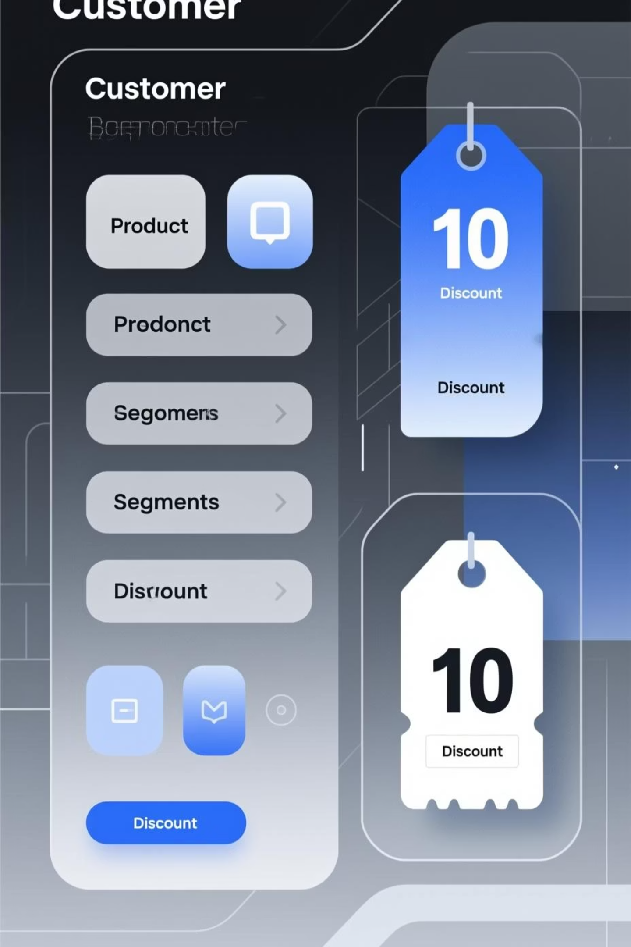
SQL Insights: Products & Segmentation
Discount-Dependent Products
Customer Segmentation
Hat (50%), Sneakers (49.66%), Coat (49.07%), Sweater (48.17%), Pants (47.37%)
Loyal (3116), New (83), Returning (701)
Top 3 Products per Category
Jewelry, Blouse, Sandals, Jacket are top items in their categories.

Slide 8
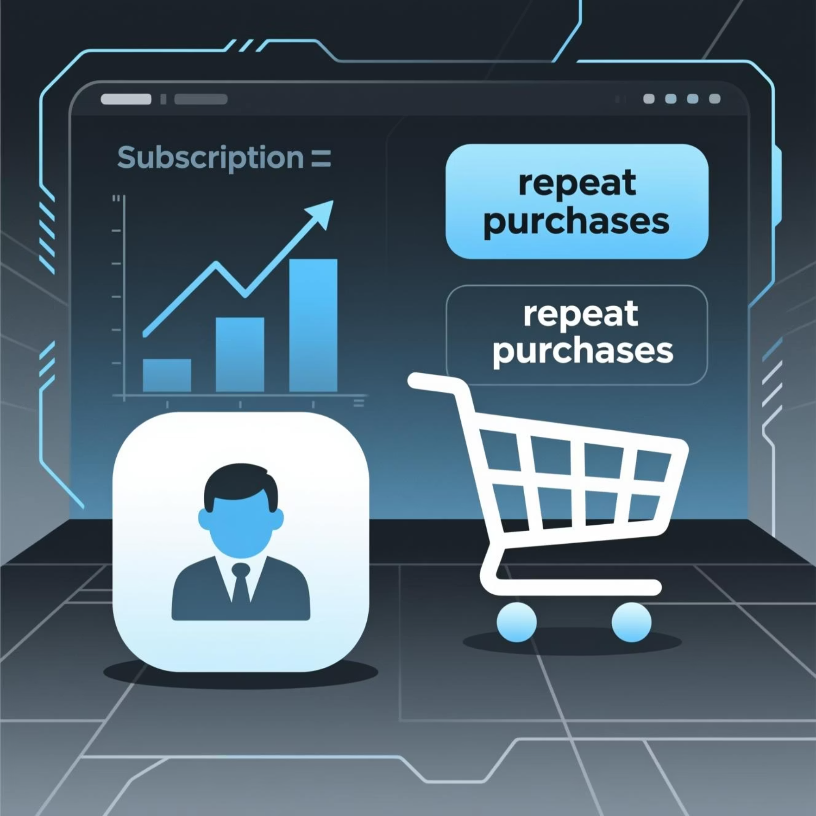

SQL Insights: Loyalty & Demographics
Repeat Buyers & Subscriptions
Revenue by Age Group
No
2518
Young Adult
$62,143
Yes
958
Middle-aged
$59,197
Customers with >5 purchases are more likely to subscribe.
Adult
$55,978
Senior
$55,763

Slide 9

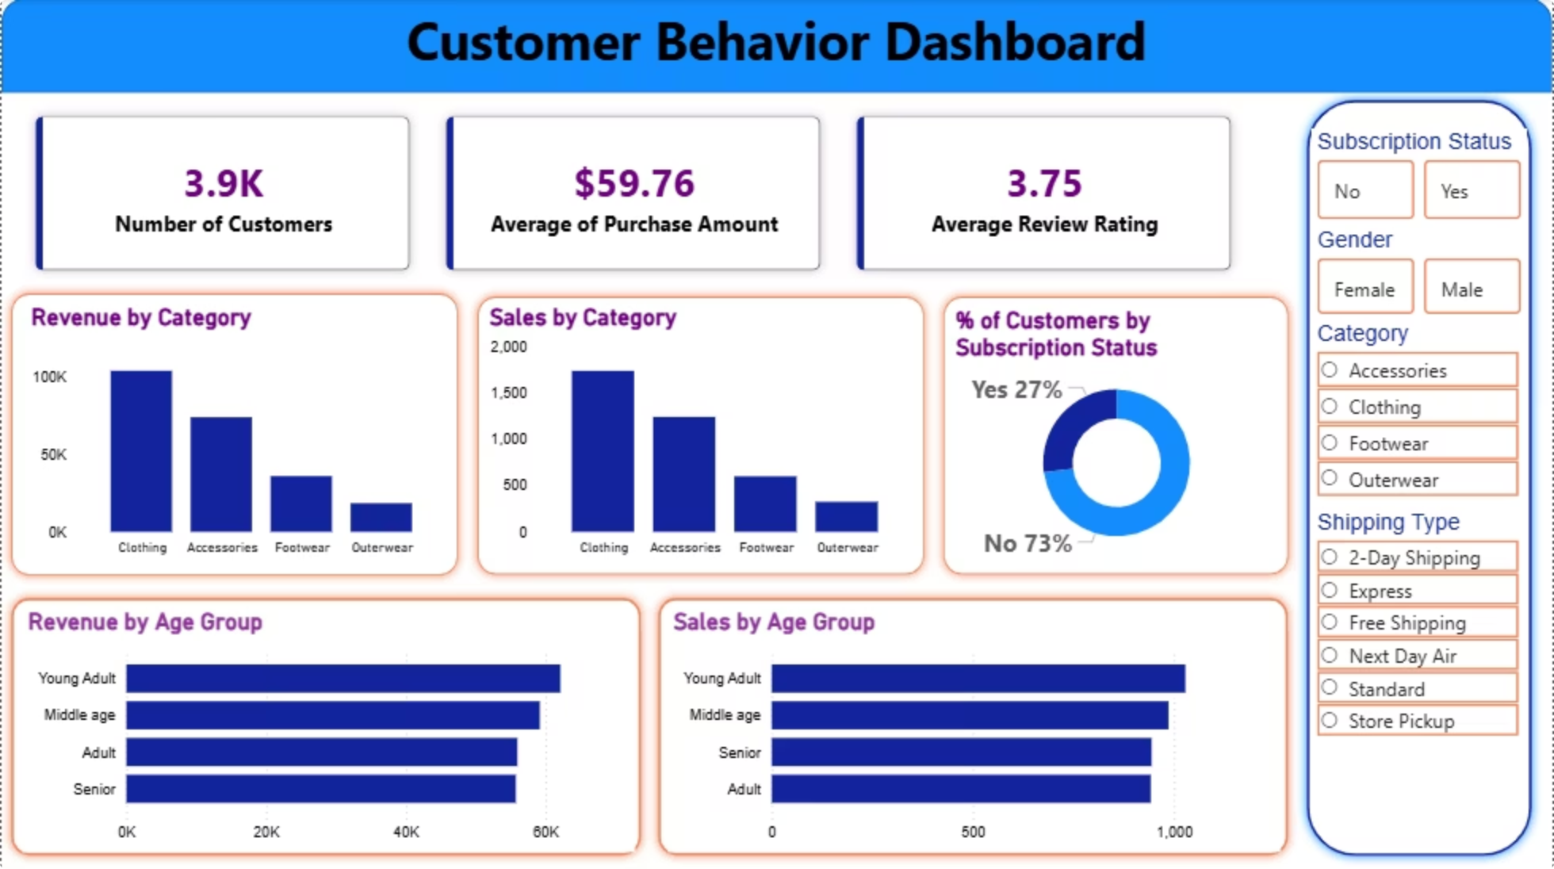
Interactive Dashboard in Power BI
Visualizing key insights for dynamic business intelligence.

Slide 10
Business Recommendations
Boost Subscriptions
Promote exclusive benefits for subscribers.
Customer Loyalty Programs
Reward repeat buyers to foster loyalty.
Review Discount Policy
Balance sales boosts with margin control.
Product Positioning
Highlight top-rated and best-selling products.
Targeted Marketing
Focus on high-revenue age groups and express-shipping users.

